Slide 1

IZMIR

Slide 2
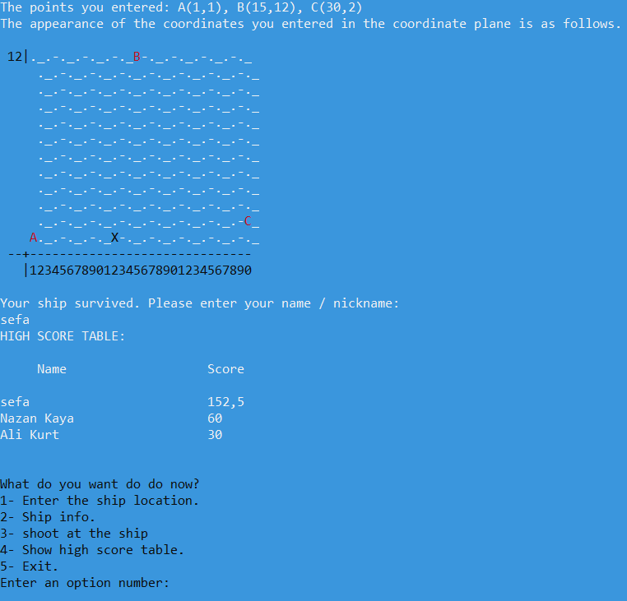
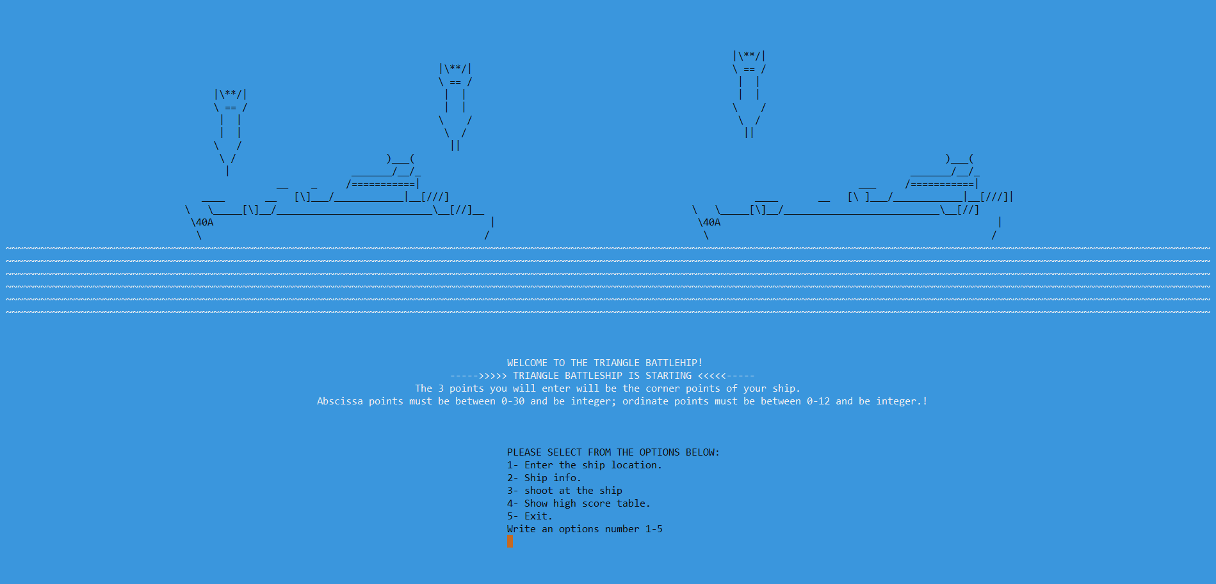
GENERAL EXPLANATION OF OUR GAME
Project was designed as one time game. The game consists with 5 choice menu. Menu choices:
1- Determining the ships location
2- Printing the ship info
3- Shooting to the ship
4- Score table
5- Exit
The user gives three point coordinates, this points consist edge’s of the ship. Then one shot is fired randomly. If the shot misses the point, user earns points as much as ship’s area.

Slide 3

Progress Summary
11.10.2021-14.10.2021
Flowchart design process
14.10.2021-20.10.2021
Everyone has written their own codes separately for first code check deadline and Sefa’s code was choosen for presentation.
25.10.2021-02.11.2021
At the given week Arda and Sefa have worked on rest of the code to complete to project and İlkin has worked on the poster design.
03.11.2021
Group has decided to choose Sefa’s code as the main code for presentation, last arrangement has been made on poster and worked on report.
04.11.2021
Last arrangements have been made for presentation.

Slide 4
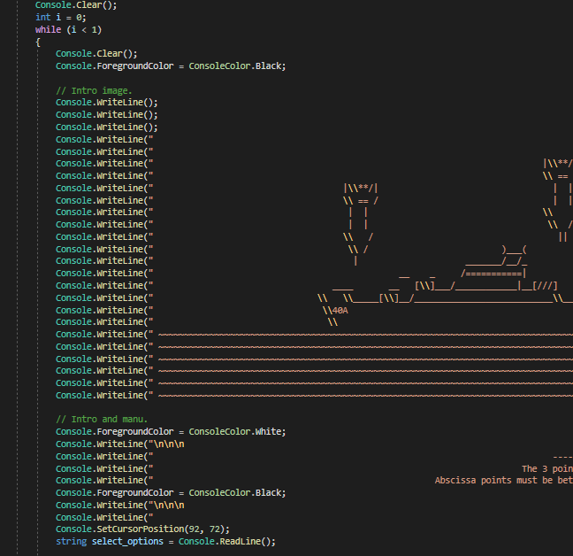
Completed Tasks
Sefa Çelik:
Took a role on designing flowchart
Completed whole coding parts
Took a role on writing report
Took a role on preparing presentation

Slide 5
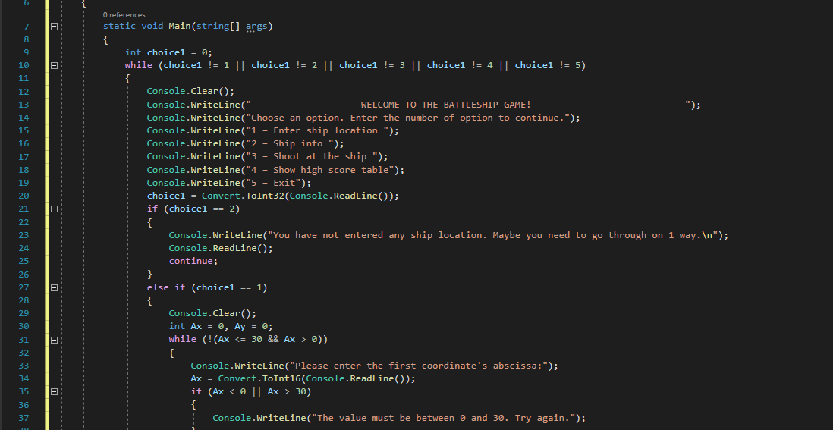
Completed Tasks
Tevfik Arda Korkmaz:
Took a role on designing flowchart
Completed whole coding parts
Took a role on writing report
Took a role on preparing presentation

Slide 6
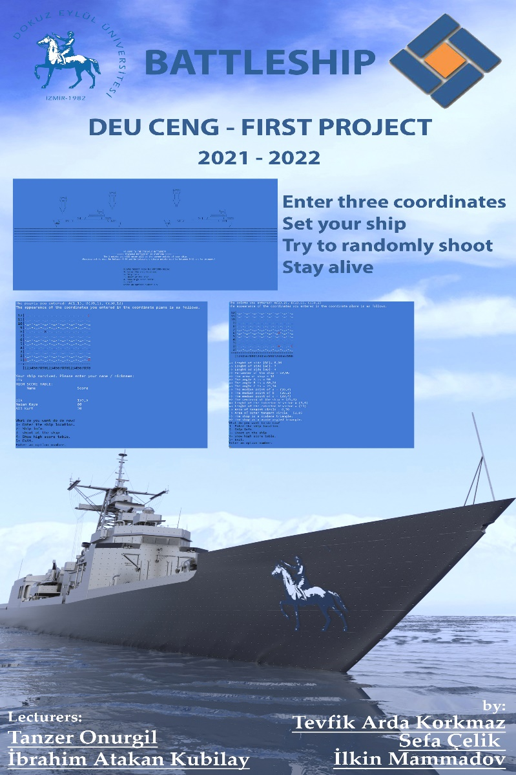
Completed Tasks
Ilkın Mammadov:
Took a role on designing flowchart
Wrote code for early stages of project
Took a role on writing report
Designed the poster

Slide 7
Additional Improvements
Sefa Çelik:
Visual attributes.
Calculating exterior bisector.
Colorizing the Project.

Slide 8
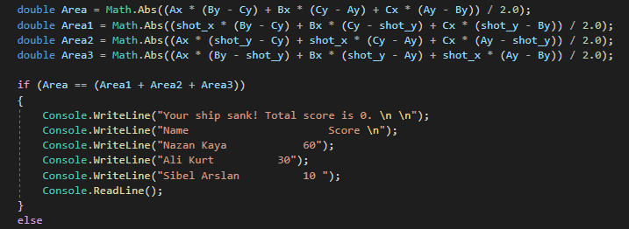
Additional Improvements
Tevfik Arda Korkmaz:
Checking that a given point is located in a given triangle or not.

Slide 9
Additional Improvements
Ilkın Mammadov:
Poster design.

Slide 10
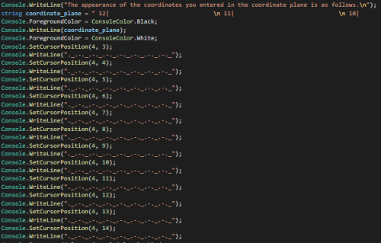
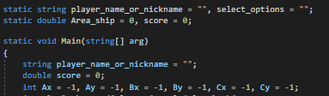
PROBLEMS ENCOUNTERED
Sefa Çelik:
Not being able to use user inputs that recieved in if and while blocks, at the out of these blocks.
One other problem was colorizing coordinate plane’s parts separately.

Slide 11
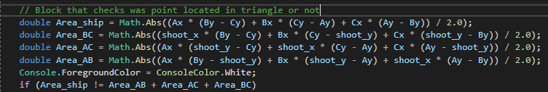
PROBLEMS ENCOUNTERED
Tevfik Arda Korkmaz:
Is given point located in given triangle or not?

Slide 12
PROBLEMS ENCOUNTERED
Ilkin Mammadov:
Printing coordinate plane on cmd window properly.

Slide 13
ALGORITHMS AND SOLUTION STRATEGIES
Sefa Çelik:
I faced with not being able to use user inputs that recieved in if and while blocks, at the out of these blocks. Then I figured out declaring these variables out of if and while blocks.
One other problem was colorizing coordinate plane’s parts separately. I found out the solution by dividing these parts in different strings and colorizing separately.

Slide 14
ALGORITHMS AND SOLUTION STRATEGIES
Tevfik Arda Korkmaz
I generally use divide and conquer technique and I applied this technique on the project. Firstly I divide project in 5 pieces. These pieces refer to choices of menu and I created main structure by using “while, break, continue” notions. Afterward I transformed mathhematical formulas into code. I think most important piece of code was that checks “is given point located in given triangle or not”. Because this algorithm is used in interviews of global tech companies. Here is the piece of code that how we solved the problem:

Slide 15
ALGORITHMS AND SOLUTION STRATEGIES
Ilkin Mammadov:
The first problem that I faced was printing coordinate plane on cmd window properly. I could not find any solution without using advanced functions. Then I decided to solve the problem by using analog way and used white spaces in Console.Writeline() function.

Slide 16
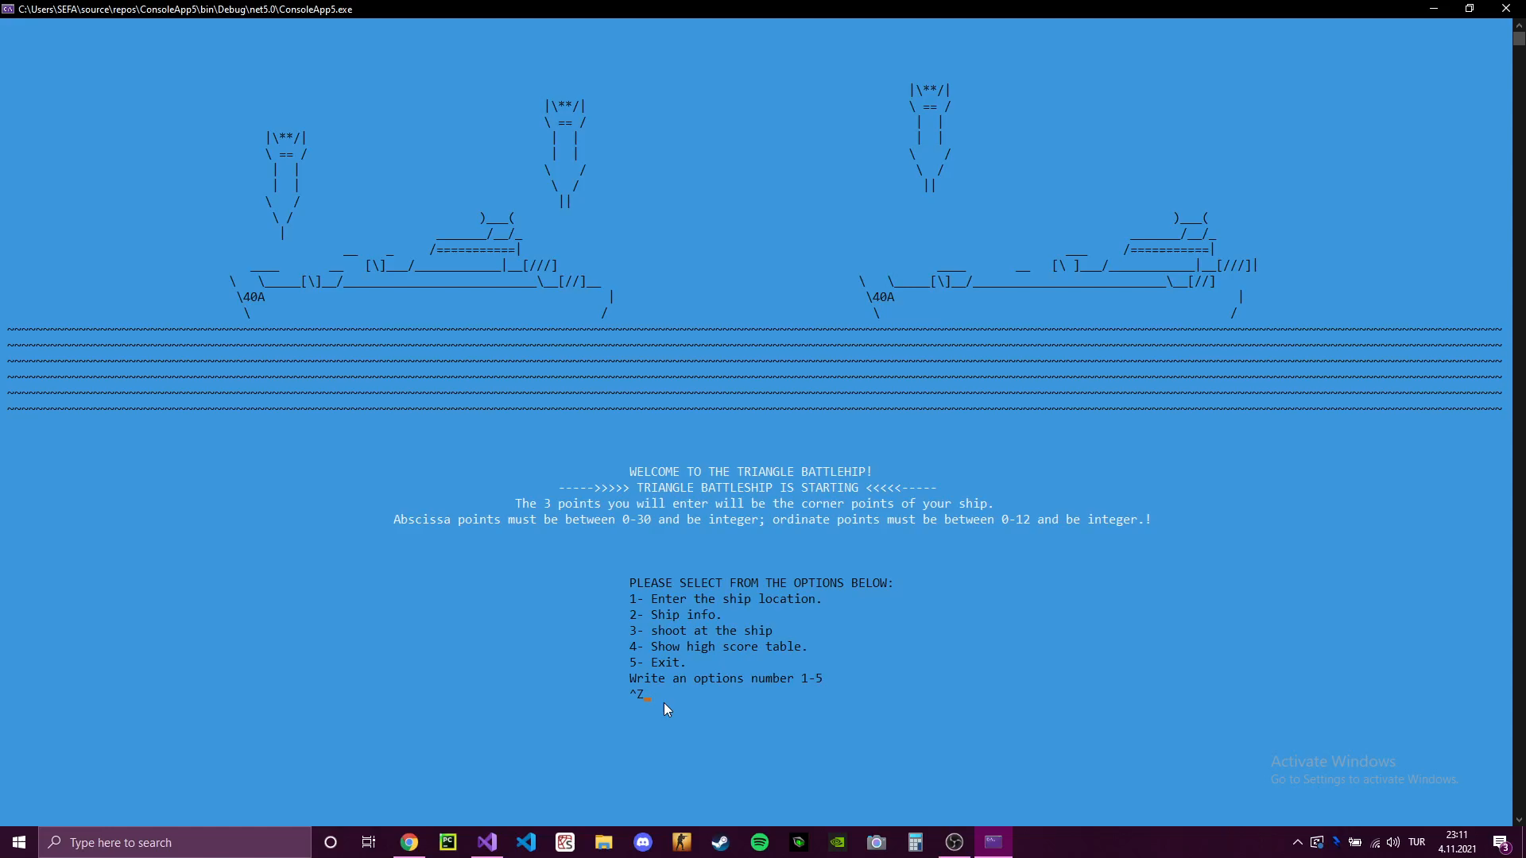
Oynanış videosu

Slide 17
conclusıon
Printing on console in C#
Getting input from user in C#
Operators in C#
SetCursor() function in C#
Colorizing background and strings in C#
Couple of Math functions in C#
Generating random number in C#
Using while and if blocks effectively
Using values from loop and condition blocks, out of blocks
We have learned how to work in group, divide one work among three and make choices together.

Slide 18

REFERENCES
https://kunduz.com/tr_tr/
https://www.w3schools.com/cs/index.php
https://www.asciiart.eu/
https://www.yazilimkodlama.com/programlama/c-console-arkaplan-ve-yazi-rengi-degistirme/

